Slide 1
WDKA student submission assignment archive
Show the website at the start of the presentation:
https://xd.adobe.com/view/f7c1c13f-bbb5-4808-85fb-53826cbcd9a4-a292/
https://miro.com/app/board/uXjVO7VqAf4=/

Slide 2
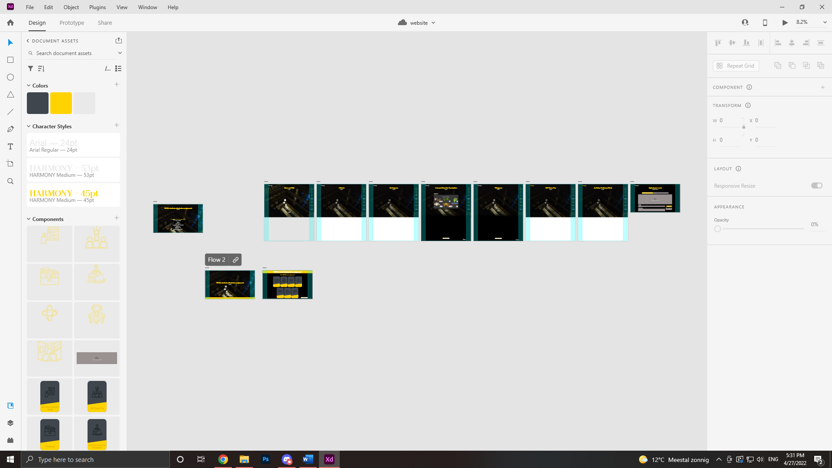
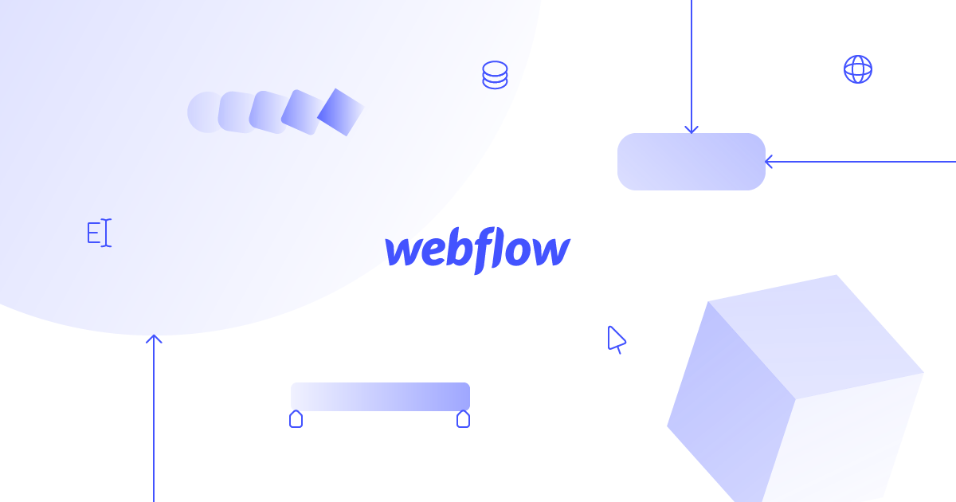
The concept
Adobe Xd file
Notes:
tommie

Slide 3
Terms of services
Privacy Policy of the artist
Only information that is being collected is of the artwork itself and the info that the artists decides to incorporate with it
We do not claim ownership of the art posted, all art and media posted is owned only by the artist
We do not use peoples works as advertisements without their permission
We provide free online storage of your content

Slide 4
messaging
Commenting
Owner can hide comments
Reinterpretation is a comment on the work itself
Notes:
Victor

Slide 5
storage
All works are written in by the assignment that the artist originally made

Slide 6
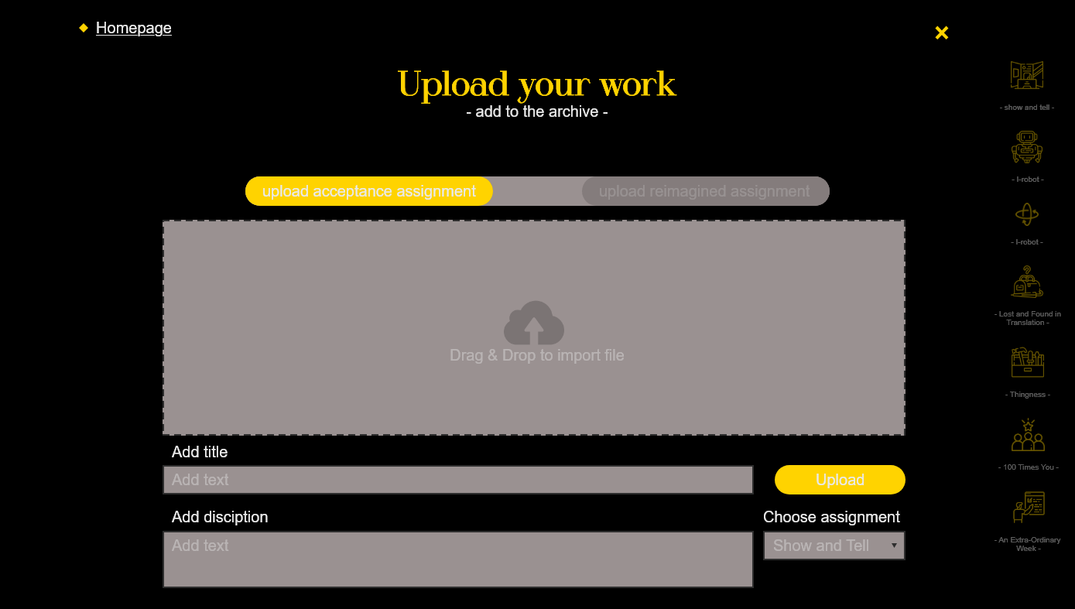
publishing
Publish original work
Publish reinterpretation work

Slide 7
autonomy
We allow people to see how they are autonomous by comparing the works they did compared to others
We also allow people to explore each others autonomy by reinterpreting and adding onto their assignments
Who is it for?
For people inside the school
See how they grew
See how the school might have chosen them as a comparison to others works
Notes:
Dana

Slide 8
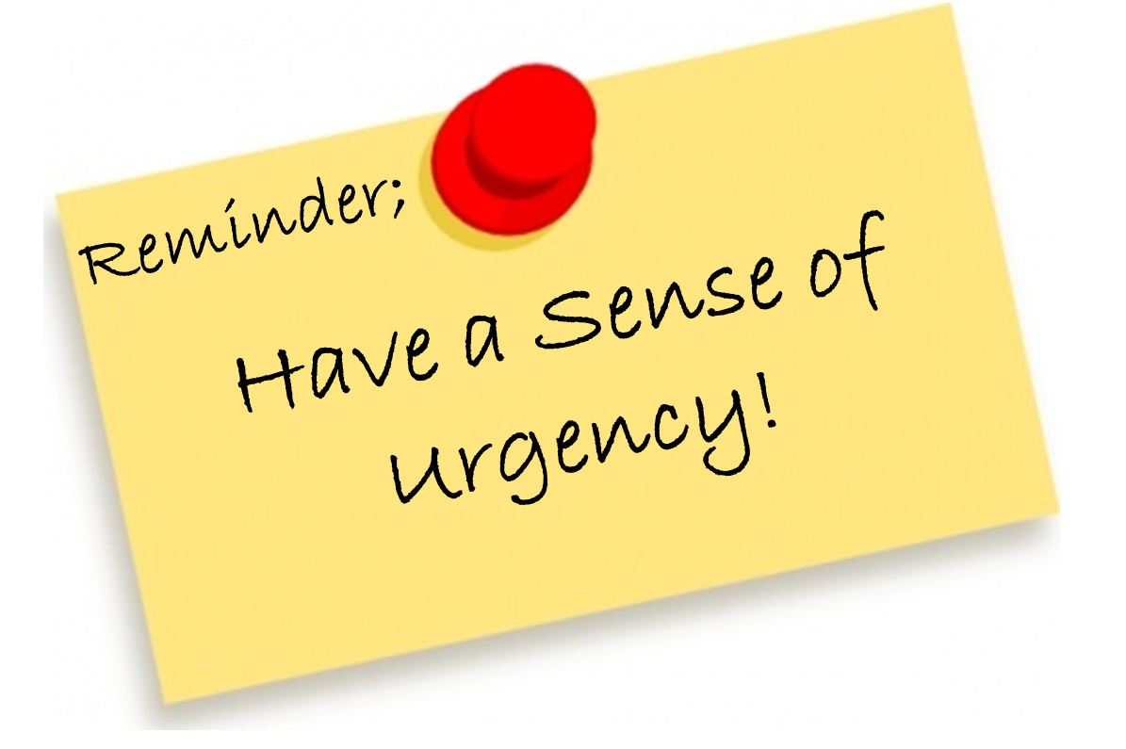
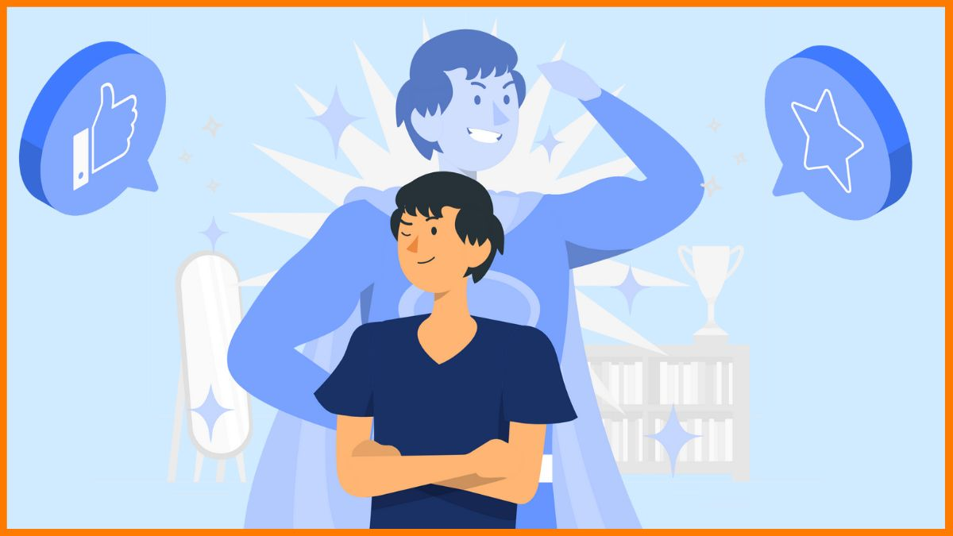
Urgency
To feel confidence in your work again
Look back in time to see your progress as an artist
Compare mindset and reflect
The urgency for this network is the need for confidence in our artworks, which we all agreed that has been lacking since we got accepted, mainly for the fact that our artistic identity somewhat feels attacked or not valued enough in our usual projects. This network therefore is to compare the difference between the mindset we had back then and now, reflect and hopefully improve in the future.
Notes:
thea

